Slide 1


CI/CD Assignment
Presented By : Deepak Kumar

Slide 2
Content
Set up Virtual Cloud Environment
Java Installation
Jenkins set up
Building Pipeline
Make a build
Run Application

Slide 3
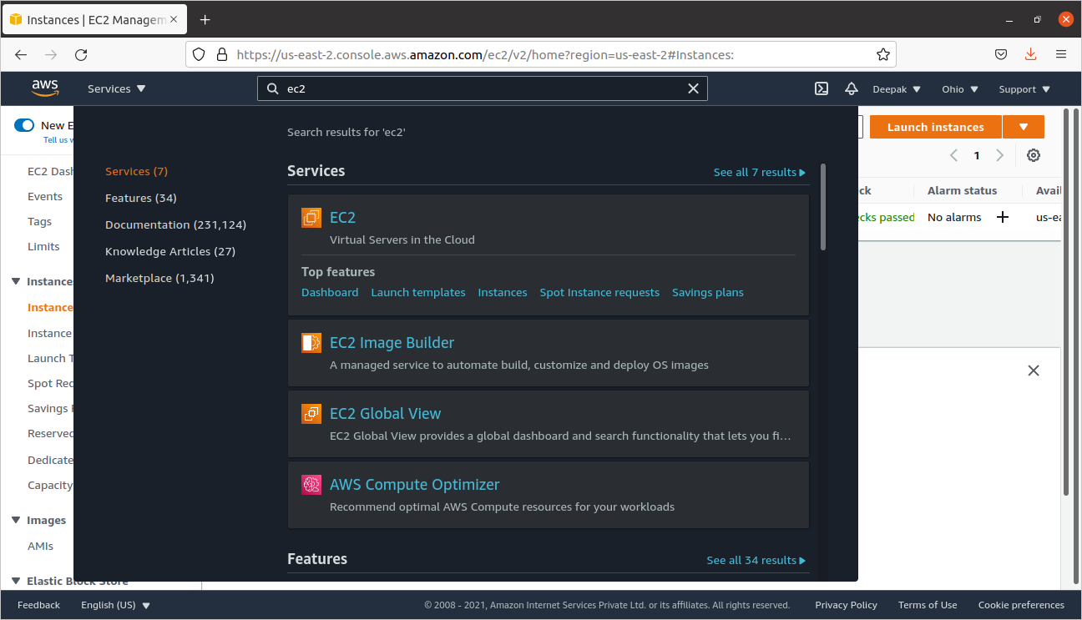
Set up Virtual Cloud Environment
Sign in to AWS console and launch the new EC2 instance

Slide 4
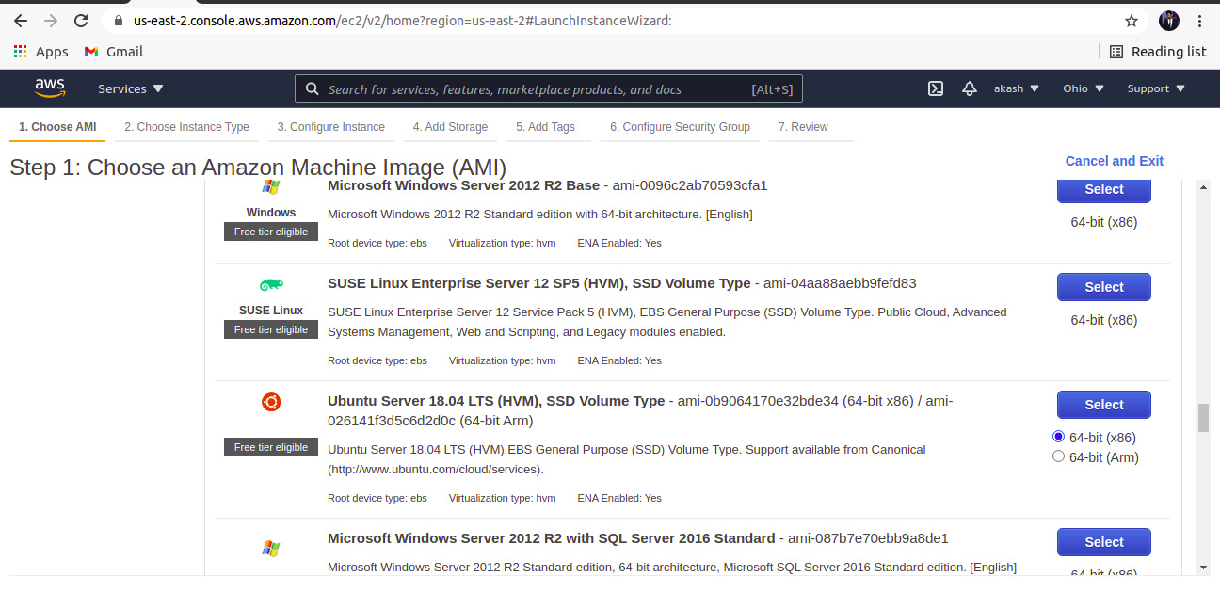
After launching the instance select the Ubuntu Server 18.04 LTS (HVM) AMI .

Slide 5
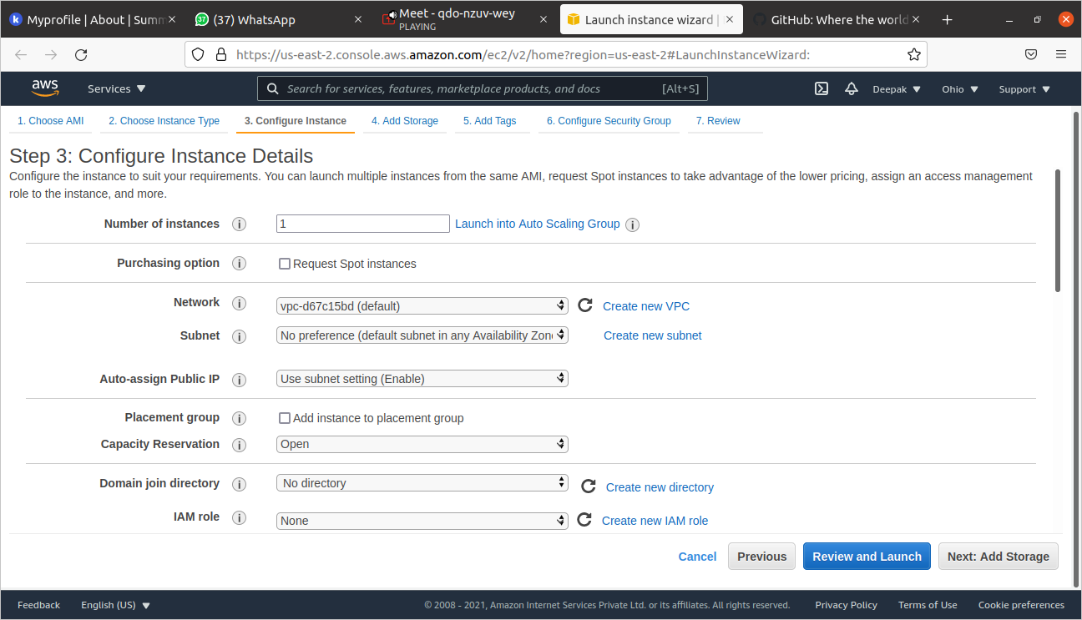
Next choose the instance type ,configure instance details,add storage and configure security groups.

Slide 6
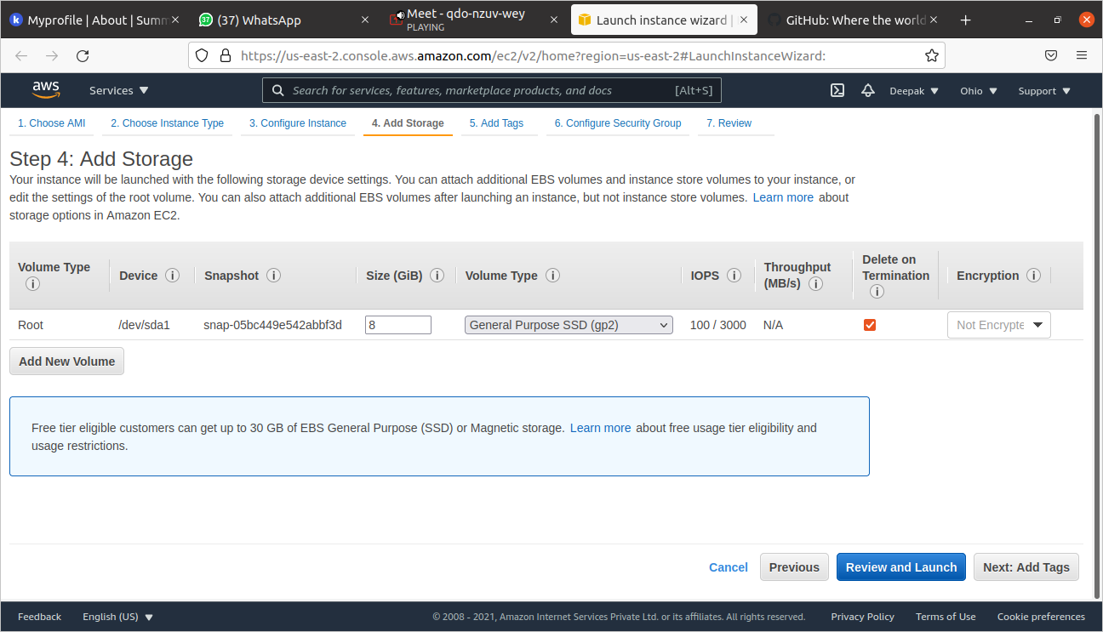

Slide 7
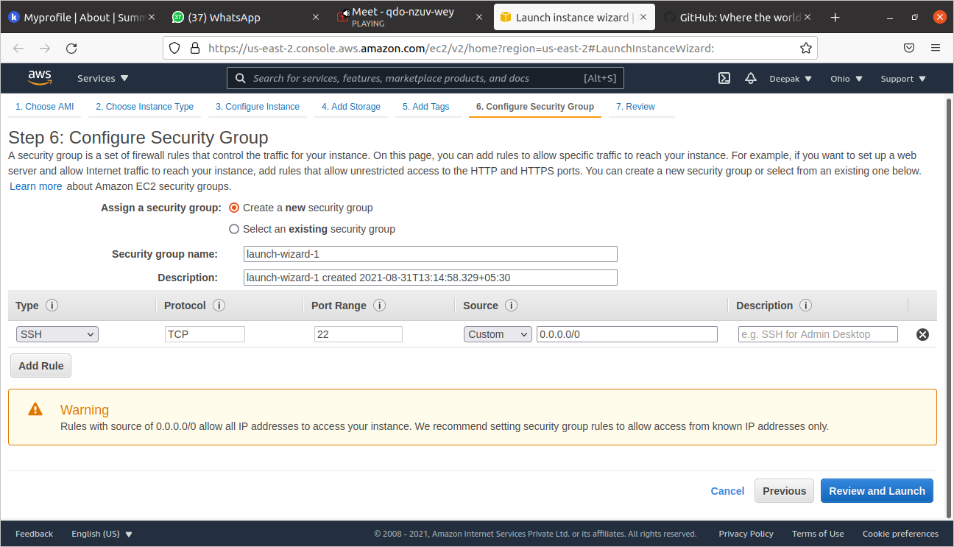

Slide 8
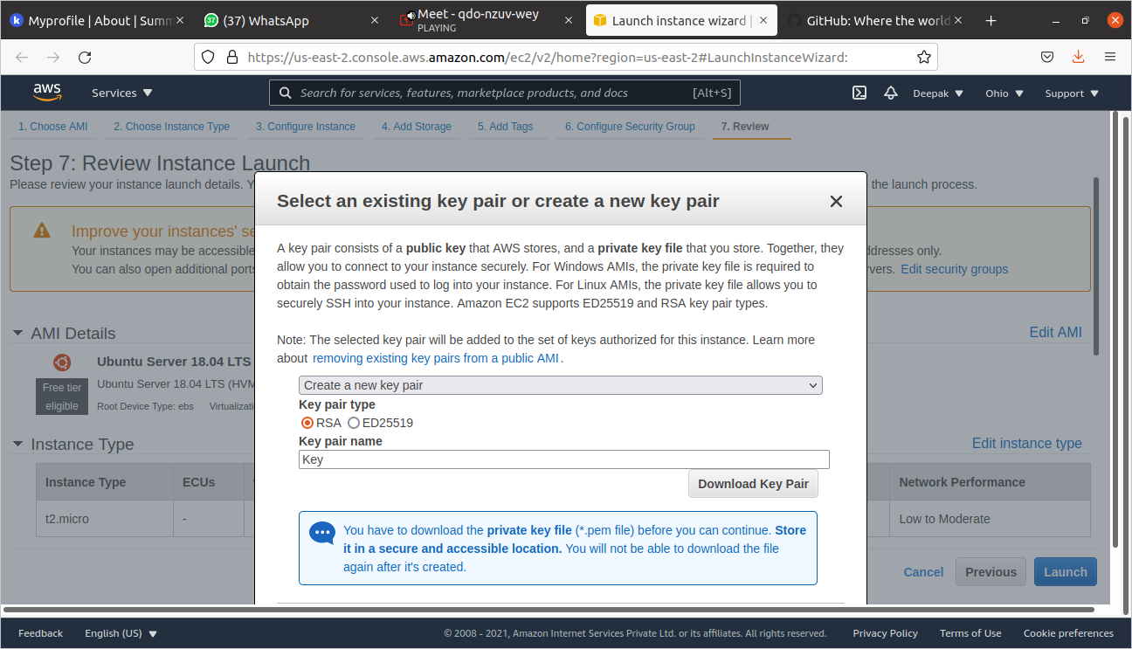
Download the key pair.

Slide 9
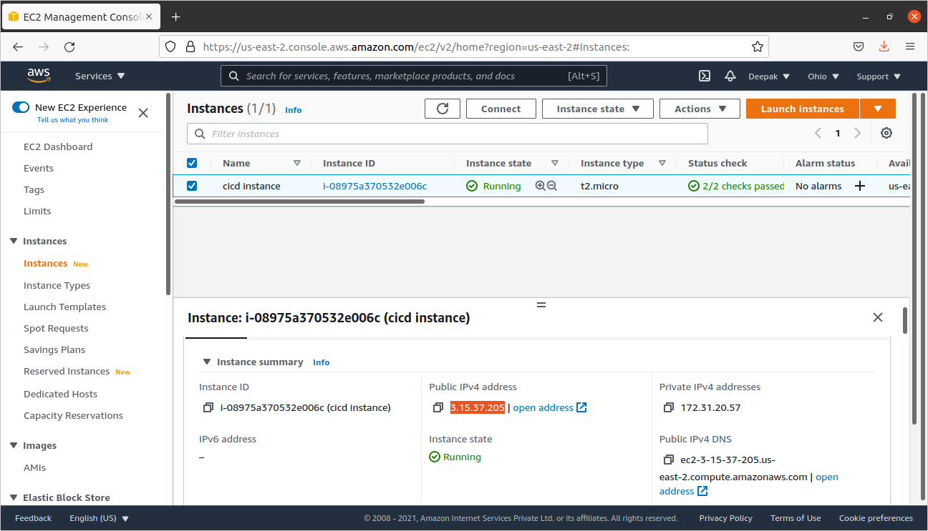
Give the proper name to instance and copy the IP address of running instance.

Slide 10
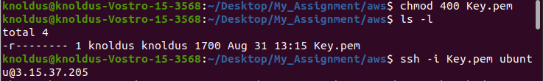
Performs the following command on terminal where our key pair is present.
Run the command - $ chmod 400 aws-key.pem , to make key publicly viewable
Open the ssh client uding the command - $ ssh -i “key-pair.pem” ubuntu@3.128.153.232.

Slide 11
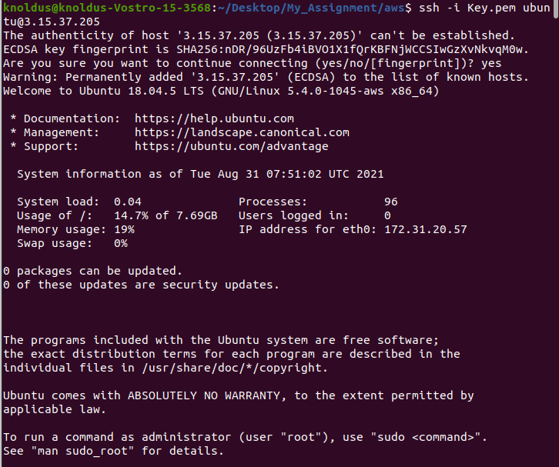

Slide 12
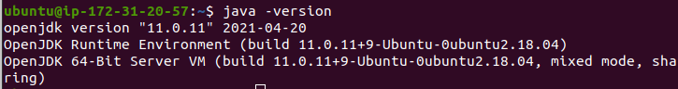
Java Installation
By using these commands install java sdk and jre
$ sudo apt-get update
$ sudo apt install openjdk-11-jre-headless

Slide 13
Jenkins Set up
Get the link of the jenkins.war file from the https://www.jenkins.io/download/
Download the jenkins war file using the command.
$ wget https://get.jenkins.io/war/2.307/jenkins.war
Change the file permissions of jenkins.war to executable using the command.
$ chmod +x jenkins.war

Slide 14
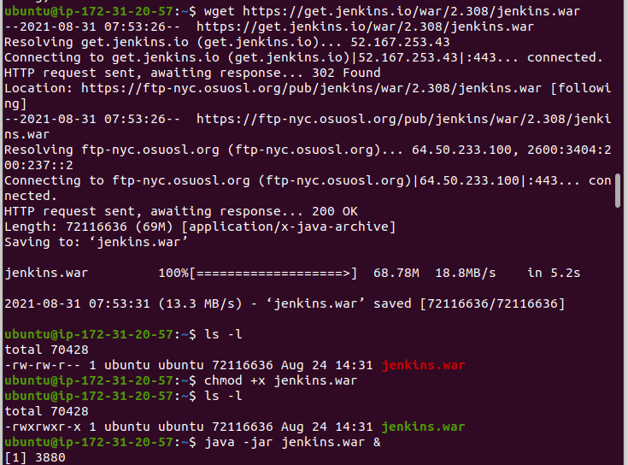

Slide 15
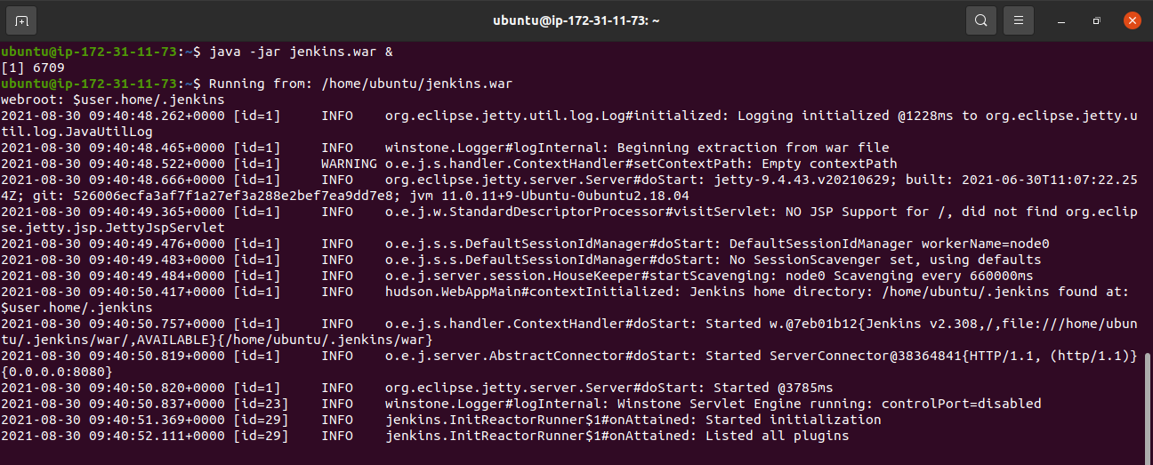
Building Pipeline
Run the jenkins over ec2 machine using the below command.
$ java -jar jenkins.war &
.

Slide 16
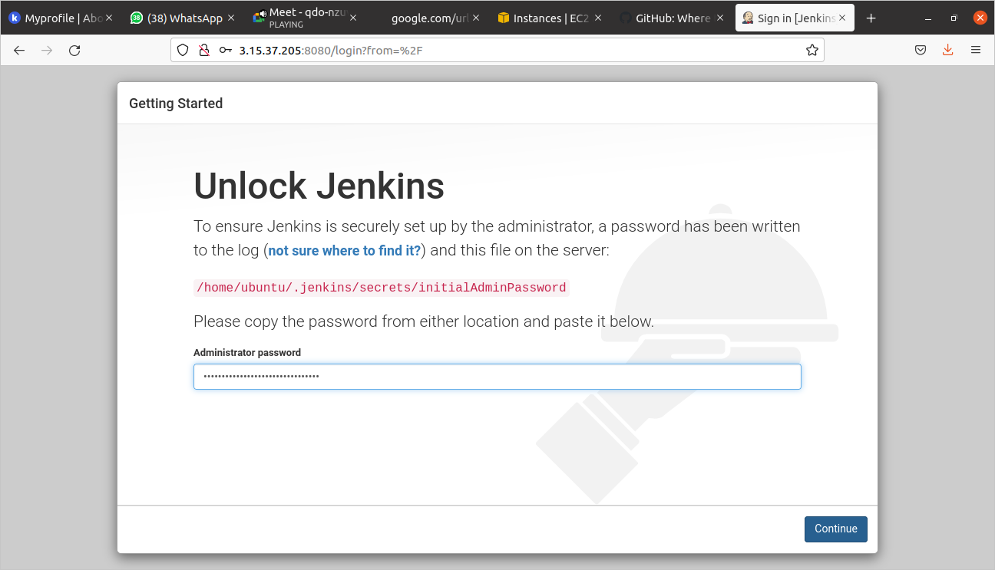
Open the browser and open the Jenkins GUI using <IP_VM>:8080.

Slide 17
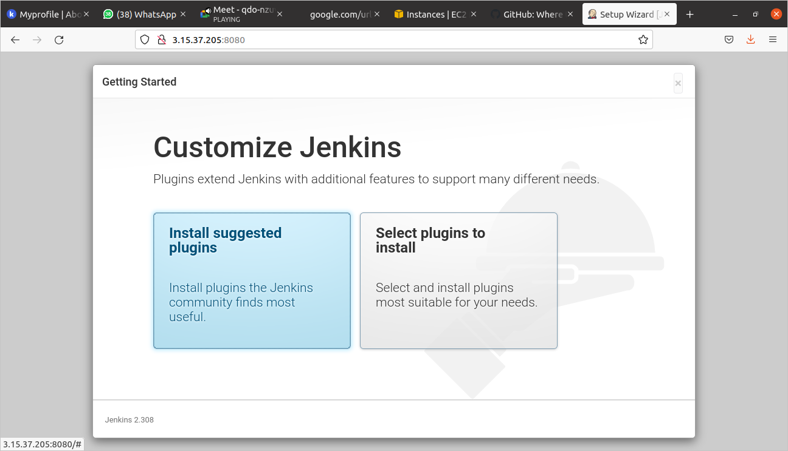
Install the suggested plugins and add a account on jenkins.
Click on start jenkins.

Slide 18
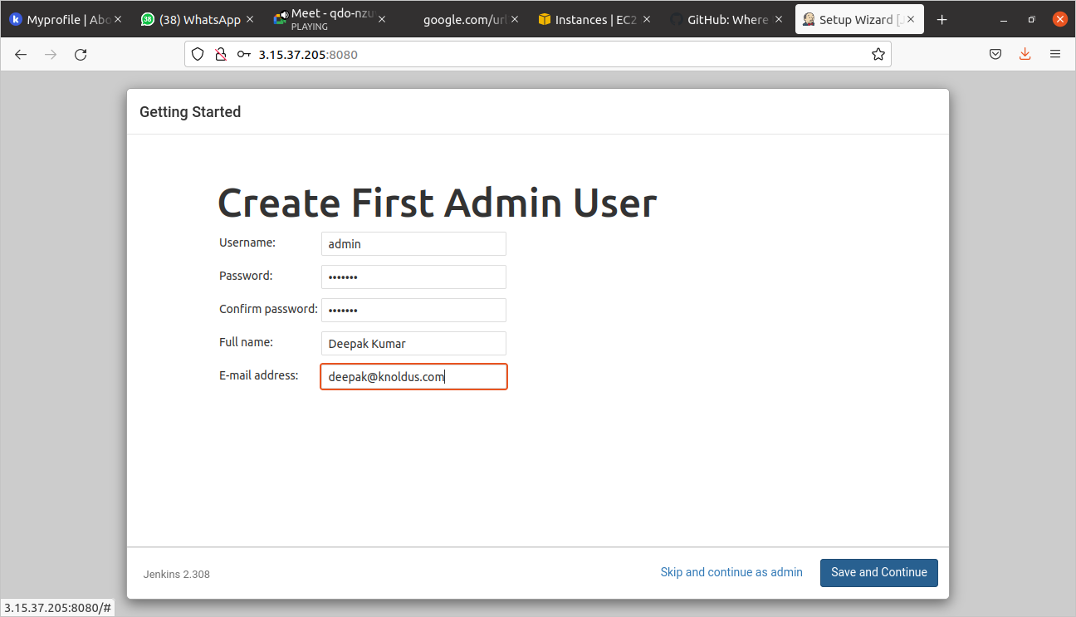
Create First Admin User

Slide 19
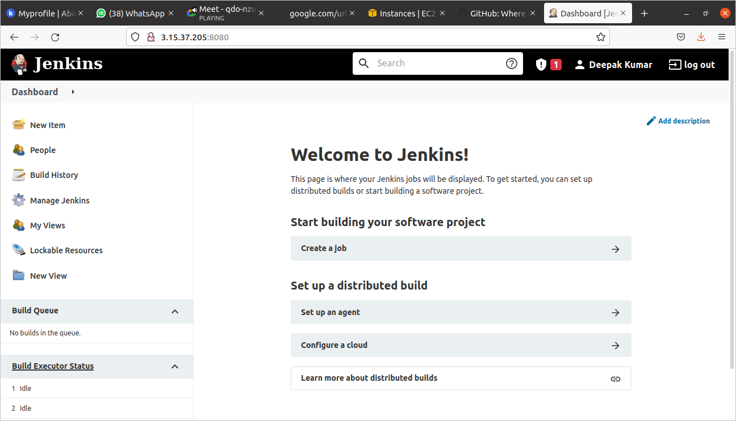
Jenkins Dashboard

Slide 20
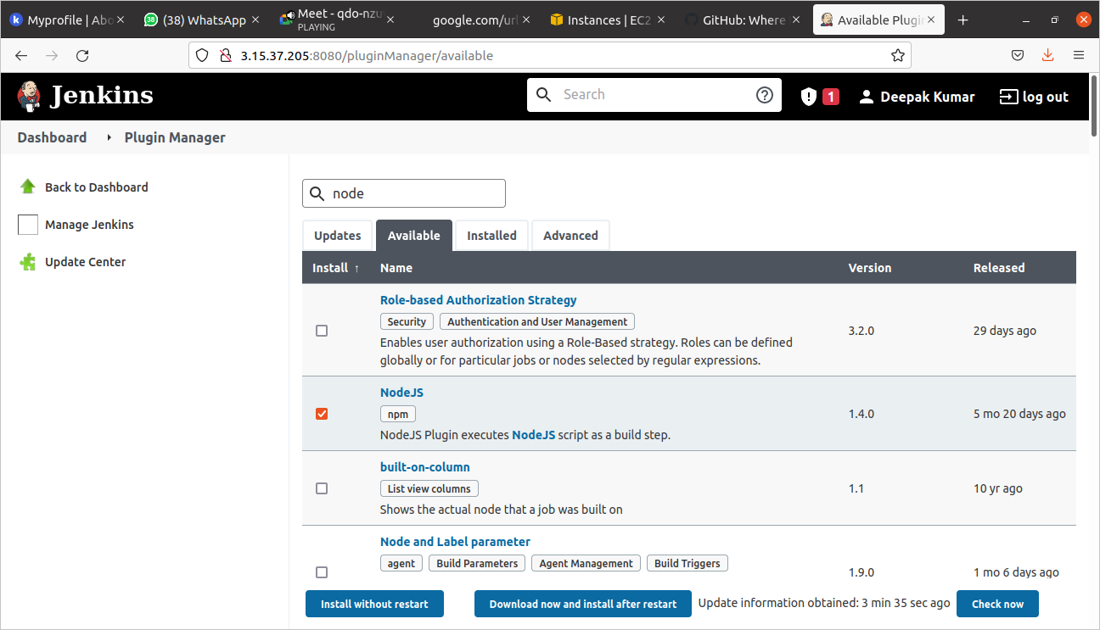
Install the NodeJs Plugin.
Add the global configuration for nodejs as show in the figures.

Slide 21
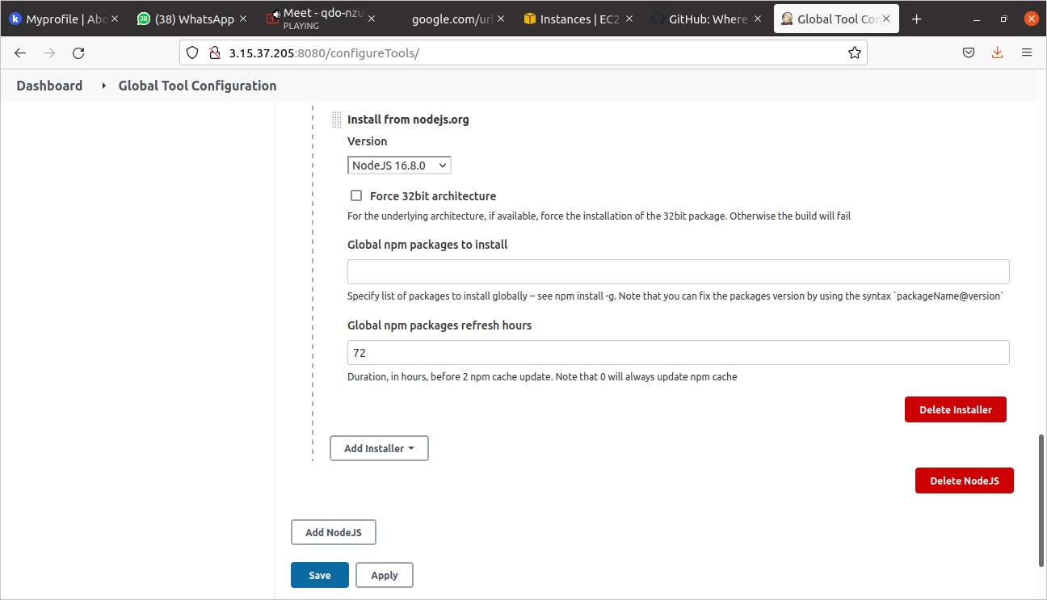

Slide 22
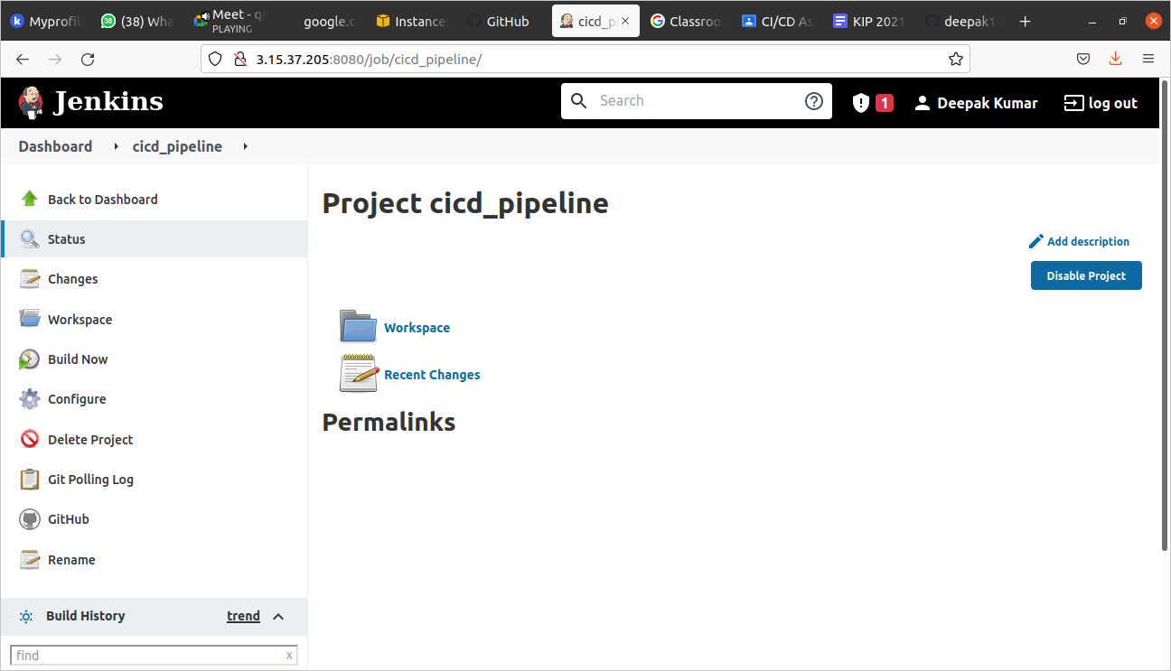
Create a new project of the freestyle type.

Slide 23
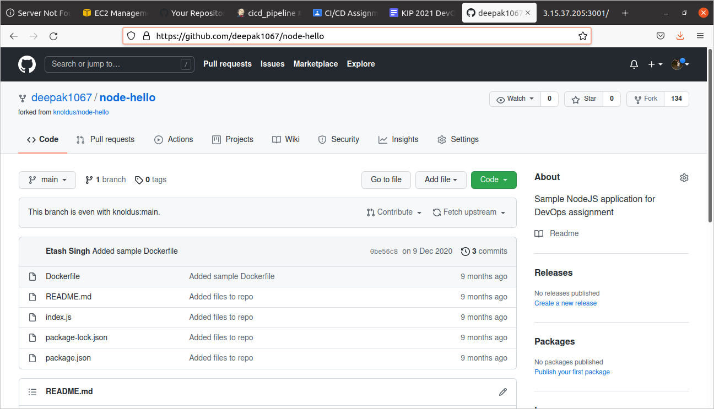
Fork the repository given at https://github.com/knoldus/node-hello into our github account.

Slide 24
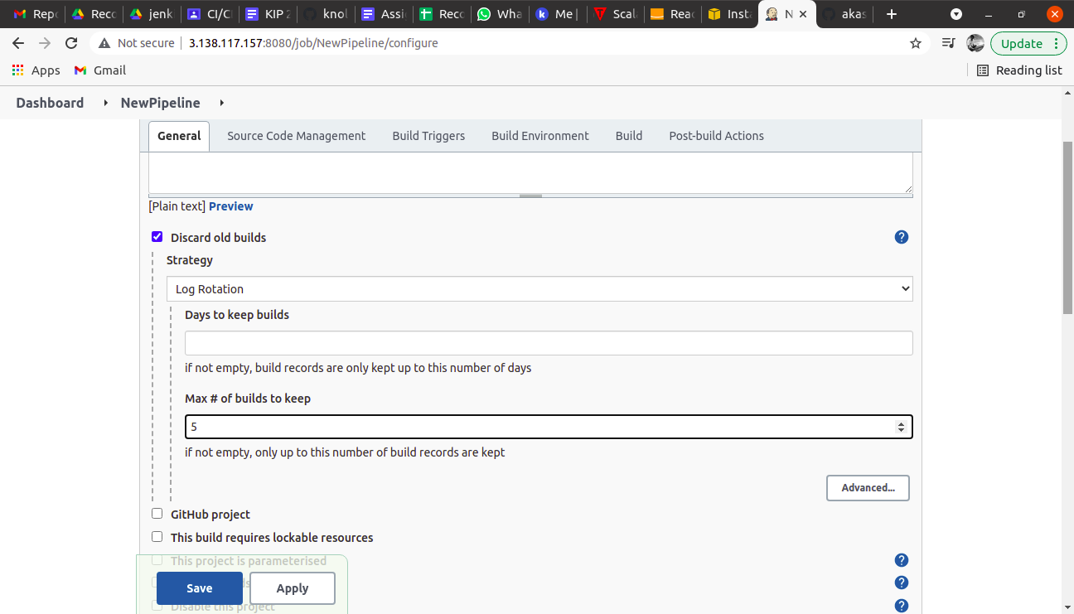
Step 7:- Perform the different build task as shown in the fig.

Slide 25
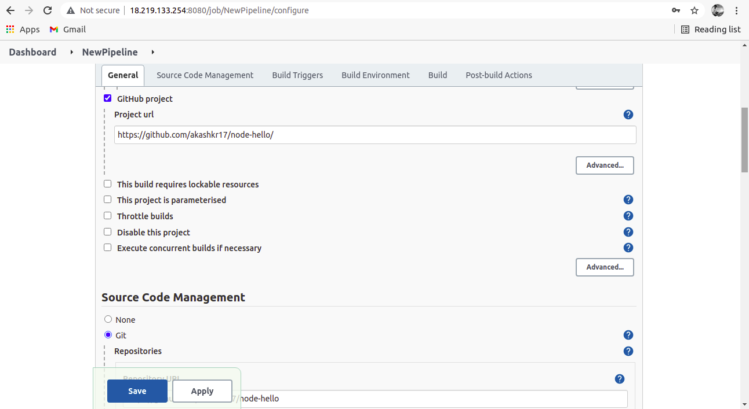
Perform the different build task.

Slide 26
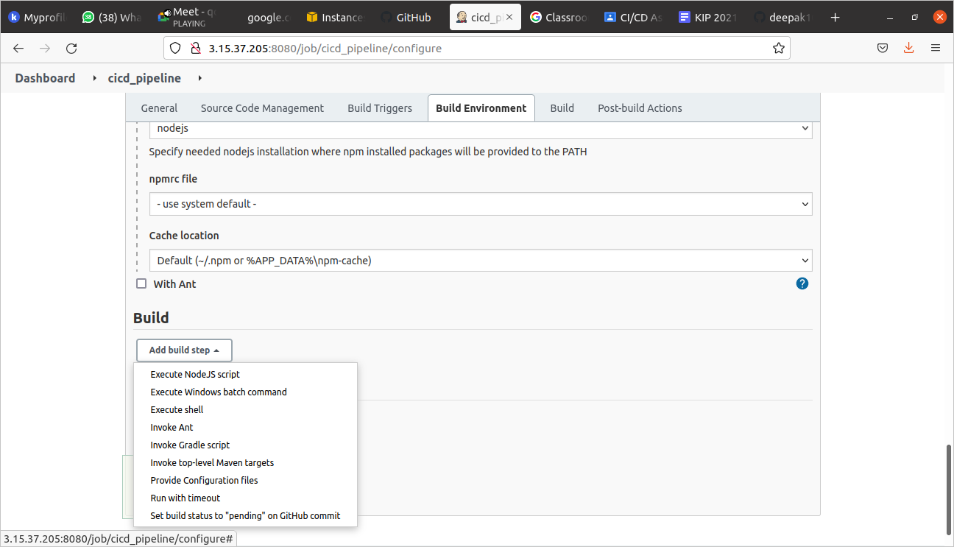

Slide 27
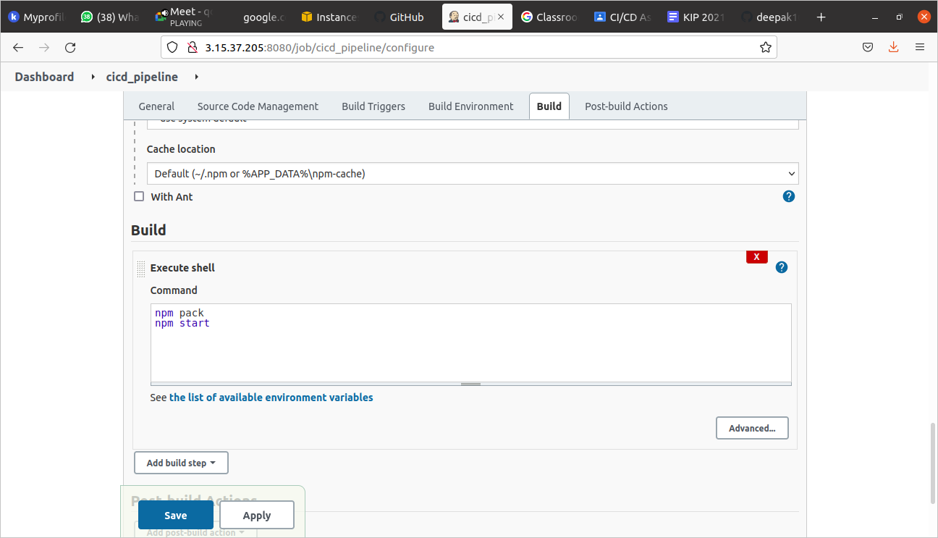
At the end save and apply the required changes.

Slide 28
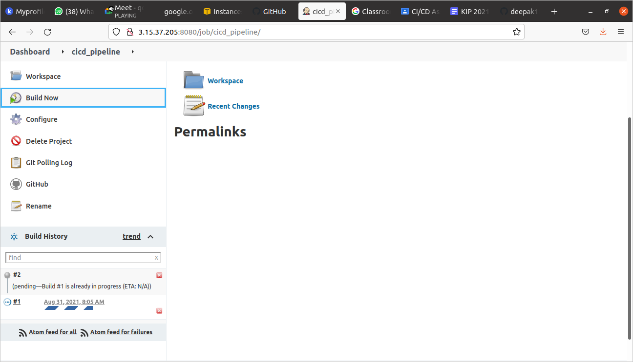
Make a Build
Click on the build now and get proper build in the console.

Slide 29
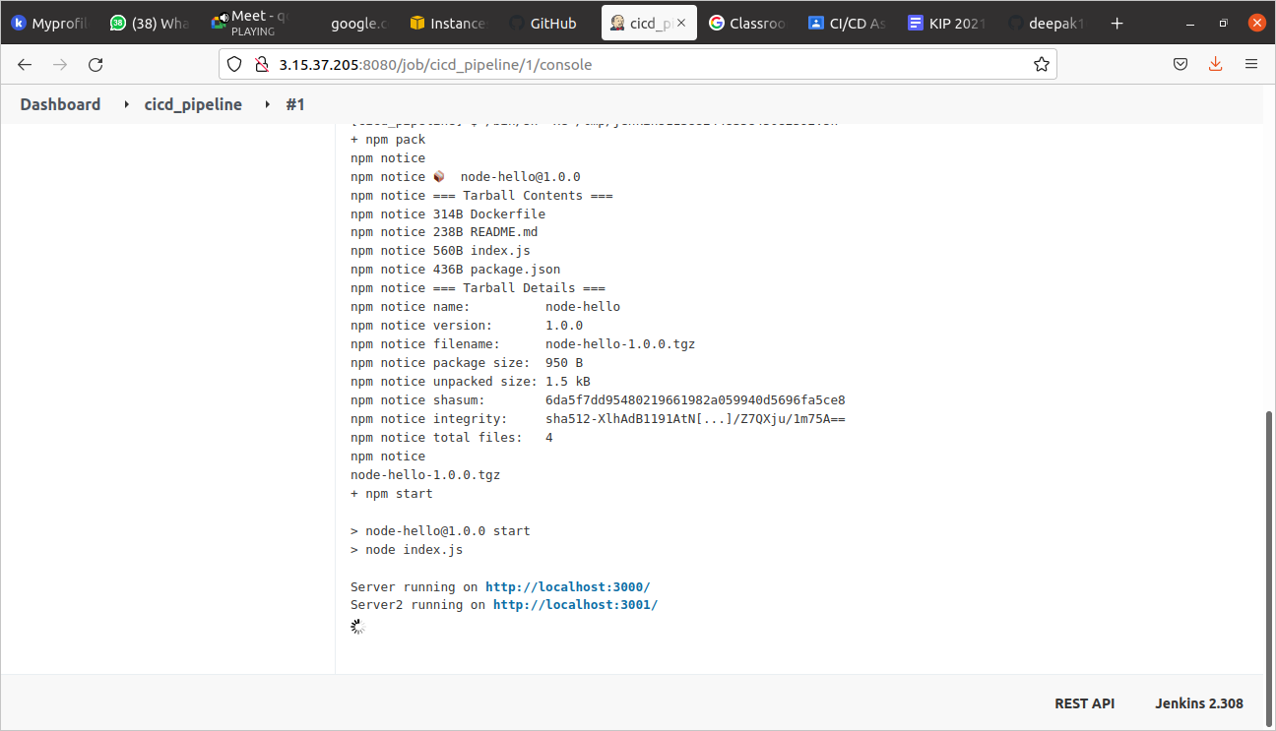

Slide 30
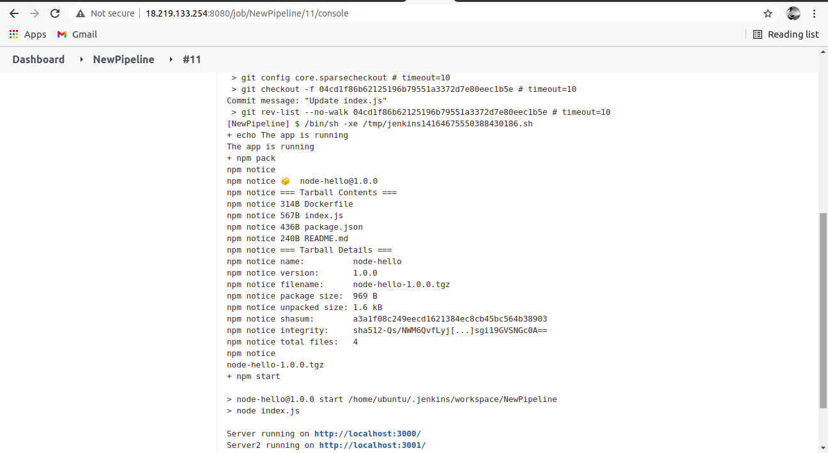

Slide 31
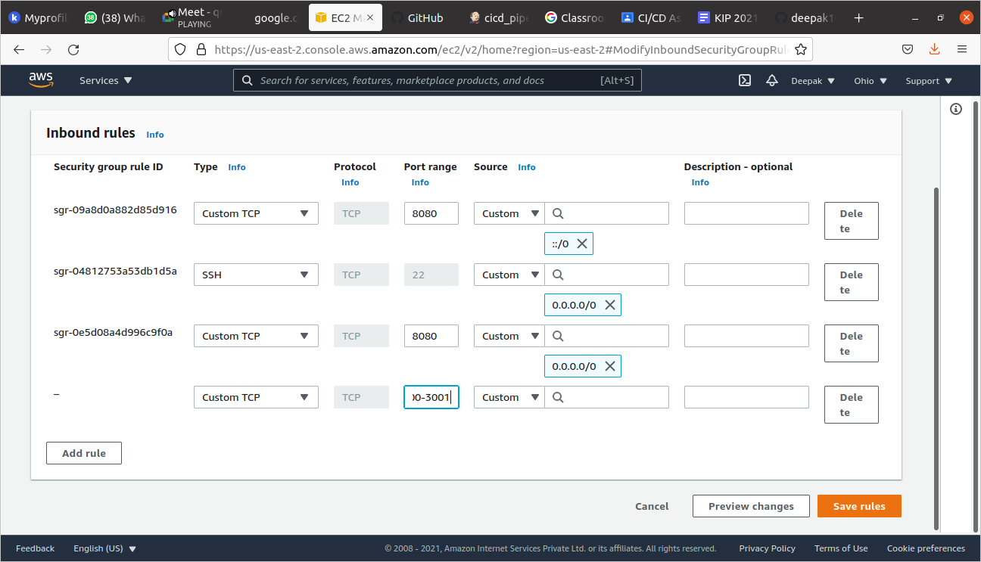
Run Application
Put the port range 3000-3001 in the ec2 instance inbound rules for validation of running app

Slide 32
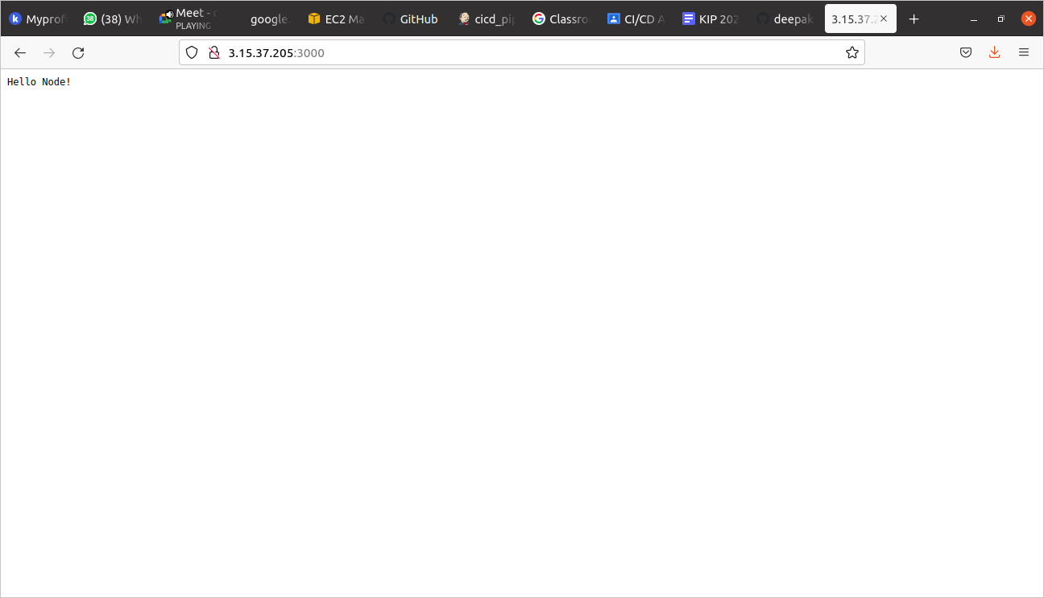
Check <IP_Address>:3000 and <IP_Address>:3001 in the browser.

Slide 33


Slide 34

Thank You!

